Slide 1
3-Connected Planar Graphs into PSLG
Using Tutte’s Embedding
Adi, Asa

Slide 2
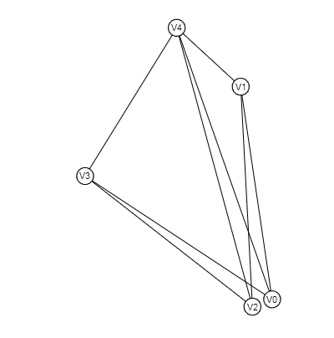
Example of 3-Connected Graph
Adjacency Matrix
Degree Matrix
0,1,0,1,1
1,0,1,0,1
0,1,0,1,1
1,0,1,0,1
1,1,1,1,0
3,0,0,0,0
0,3,0,0,0
0,0,3,0,0
0,0,0,3,0
0,0,0,0,3

Slide 3
Tutte’s Embedding
Consider vertices have 1 unit weight and Edges are spring Connecting them
Adjacency Matrix
Degree Matrix
0,1,0,1,1
1,0,1,0,1
0,1,0,1,1
1,0,1,0,1
1,1,1,1,0
3,0,0,0,0
0,3,0,0,0
0,0,3,0,0
0,0,0,3,0
0,0,0,0,3

Slide 4
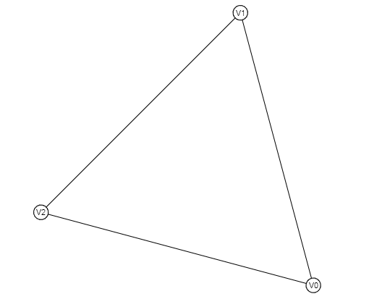
Peripheral Face
Consider this to be Peripheral Face
The face which encloses all the vertices
In this graph, any face could be peripheral face
Adjacency Matrix
Degree Matrix
0,1,0,1,1
1,0,1,0,1
0,1,0,1,1
1,0,1,0,1
1,1,1,1,0
3,0,0,0,0
0,3,0,0,0
0,0,3,0,0
0,0,0,3,0
0,0,0,0,3

Slide 5
Springs Pulling the Weight
Consider this to be Peripheral Face and Has fixed Co-ordinates
Adjacency Matrix
Degree Matrix
Laplacian Matrix
Co-ordinates
0,1,0,1,1
1,0,1,0,1
0,1,0,1,1
1,0,1,0,1
1,1,1,1,0
3,0,0,0,0
0,3,0,0,0
0,0,3,0,0
0,0,0,3,0
0,0,0,0,3
3,-1, 0,-1,-1
-1, 3,-1, 0,-1
0,-1, 3,-1,-1
-1, 0,-1, 3,-1
-1,-1,-1,-1, 3
a1,b1
a2,b2
a3,b3
x1,y1
x2,y2
By Solving the Laplacian Matrix we can find the co-ordinates of other points

Slide 6
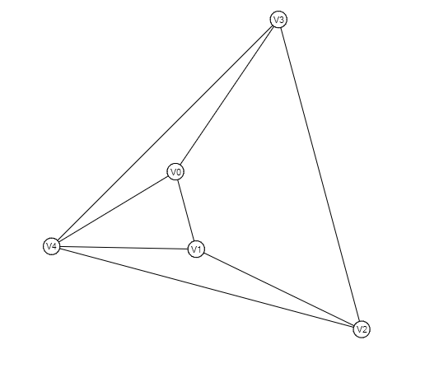
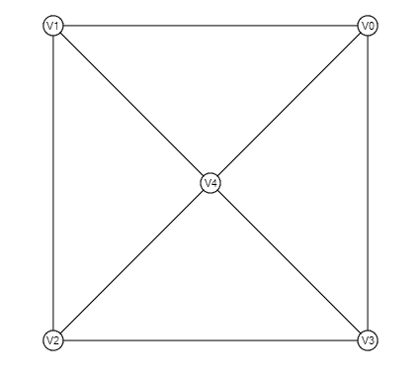
Final Product

